Slide 1
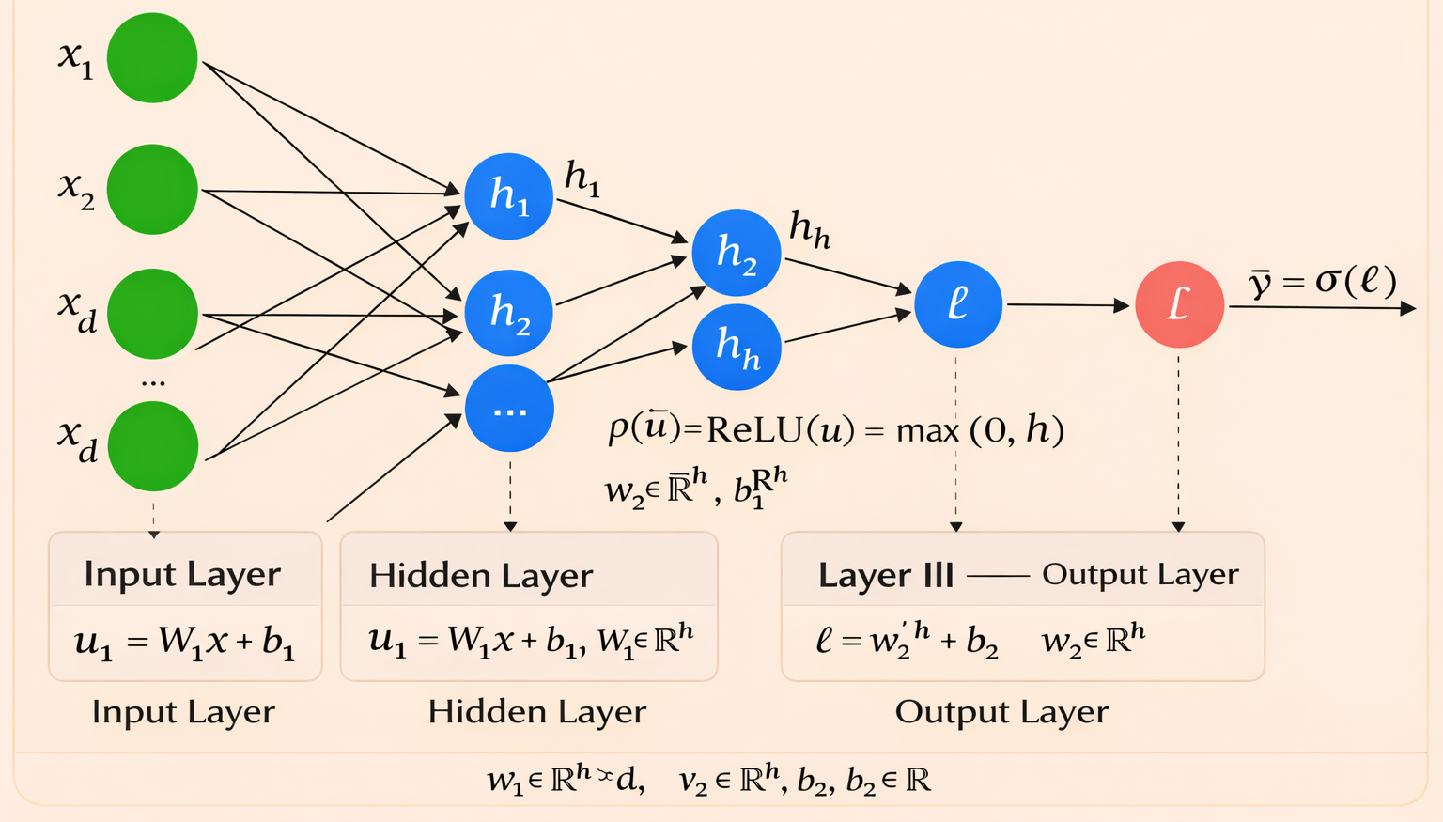
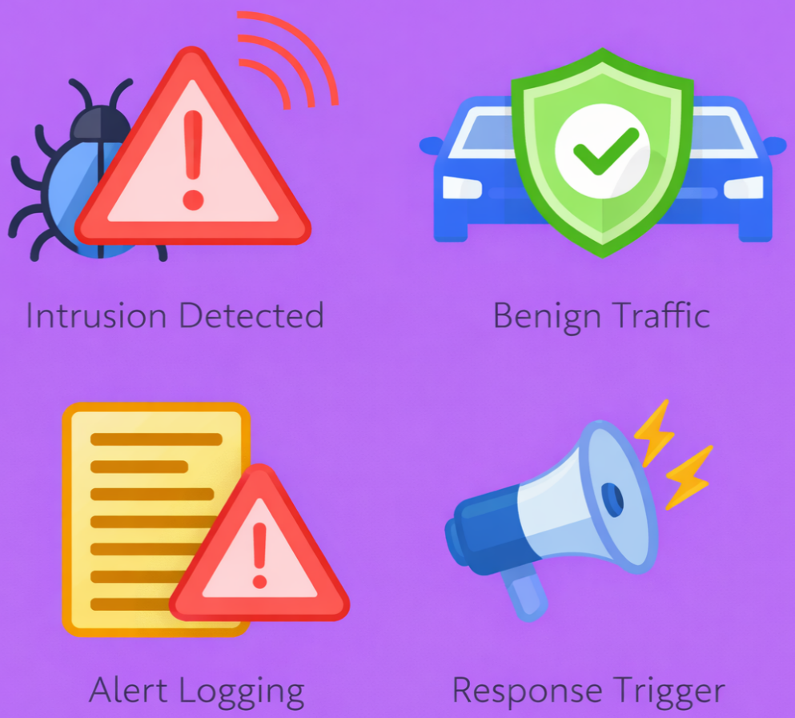
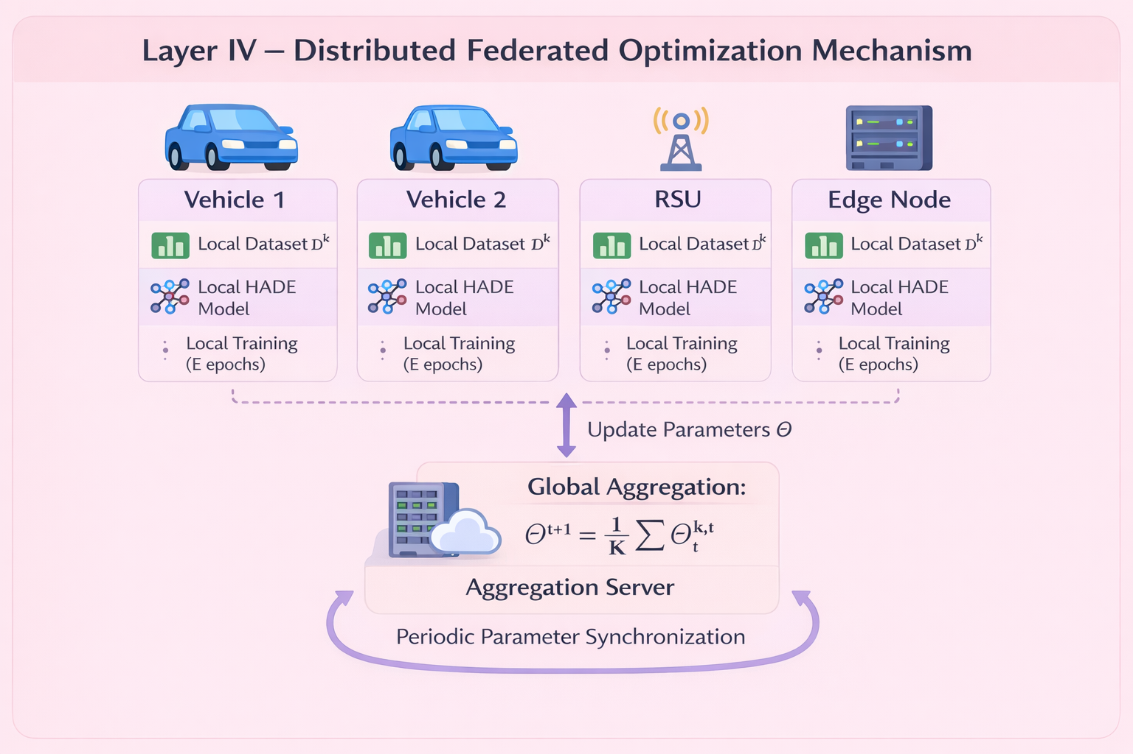
Layer II - HERCULES Adaptive Decision Engine (HADE)
Layer III: Operational Risk
Calibration
Output Layer
Layer I - Statistical Guard (Edge-Level)
V2X Communication Stream
Feature Construction & Normalization
Deviation Score: sₜ = (1/d) Σ |xₜⱼ|
Average Probability: p̄
In-Vehicle CAN Frames
V2X Messages (V2V, V2I, V2C)
Message Structure:
Identifier (𝜄ₜ)
Payload Vector (πₜ)
Length Indicator (δₜ)
Auxiliary Flag (ϛₜ)
Identifier Encoding
Mapping ϕ(𝜄ₜ) → uₜ
Decision: gₜ(τ) = 1 if sₜ > τ
Alert Rate: ĉ(η)
Payload Conversion
πₜ → Numeric Vector
gₜ = 1
gₜ = 0
Intrusion Detected
Benign Traffic
Structured Frame
Intrusion Probability
Final Decision Policy
Normalized Feature Flow
Low-Latency Deterministic Filter
Risk Score: R(α,β) = αĉ + βp̄
Standardization
xₜ = (rₜ − μ) / σ
Immediate Anomaly Alert
Forward to HADE
Alert Logging
Response Trigger
Standardized Feature Vector xₜ ∈ ℝᵈ
Deployment-Level Threshold Tuning
Message at time t: mₜ = (𝜄ₜ, πₜ, δₜ, ϛₜ)
Low-Latency Deterministic Filter
Security Decision Output

Slide 2
Layer II - HERCULES Adaptive Decision Engine (HADE)
V2X Communication Stream
Feature Construction & Normalization
Layer I - Statistical Guard (Edge-Level)
In-Vehicle CAN Frames
V2X Messages (V2V, V2I, V2C)
Message Structure:
Identifier (𝜄ₜ)
Payload Vector (πₜ)
Length Indicator (δₜ)
Auxiliary Flag (ϛₜ)
Deviation Score: sₜ = (1/d) Σ |xₜⱼ|
Payload Conversion
πₜ → Numeric Vector
Decision: gₜ(τ) = 1 if sₜ > τ
Identifier Encoding
Mapping ϕ(𝜄ₜ) → uₜ
gₜ = 1
Structured Frame
Low-Latency Deterministic
Filter
gₜ = 0
Normalized Feature Flow
Standardization
xₜ = (rₜ − μ) / σ
Immediate Anomaly Alert
Forward to
HADE
Message at time t: mₜ = (𝜄ₜ, πₜ, δₜ, ϛₜ)
Standardized Feature Vector xₜ ∈ ℝᵈ
Low-Latency Deterministic Filter
Layer III: Operational Risk
Calibration
Output Layer
Average Probability: p̄
Alert Rate: ĉ(η)
Intrusion
Probability
Final Decision
Policy
Intrusion Detected
Benign Traffic
Risk Score: R(α,β) = αĉ + βp̄
Deployment-Level Threshold Tuning
Alert Logging
Response Trigger
Security Decision Output

Slide 3
